Slide 1
How to clone a game
In this case – Pong.

Slide 2
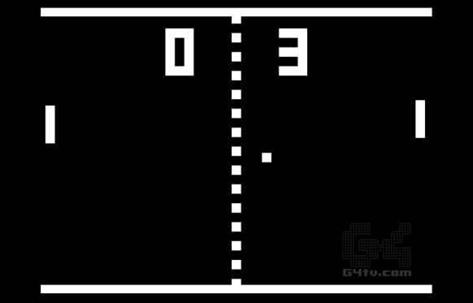
What is Pong?
1972 simple two player Atari Arcade game – loosely based on table tennis
Each player must defend their side of the screen from the ball with a bat.
A point is scored when the ball escapes off screen on the other side.
Video: https://www.youtube.com/watch?v=it0sf4CMDeM

Slide 3
How to clone it? – Break it down.
Divide the whole game up into smaller understandable objects.
Here’s a list of things in the game that we can see by looking at it:
Bat (x2)
Ball
Wall (x2)
Score
Dotted line thing in the middle (this actually isn’t that important to the game)
That’s a great starting point for turning it into code.

Slide 4
Then.. break down what the parts do
So take the walls at the top and bottom of the screen. They:
Exist
The ball collides with the shape of them and bounces off
Are drawn on the screen at a certain place as grey-ish rectangles
That’s it!
To turn that into code we might:
Make a Wall class
Give it a defined rectangular shape
Create a class function that draws the rectangular shape on the screen

Slide 5

Now the Bat
What does it do?
Has rectangular shape that ball collides with
Shape is drawn on the screen
Shape can be moved up and down by player input
Two sets of controls – one for each player
Turn that into code
Defined rectangular shape
Movement speed
A draw function
Input key processing to set whether bat is moving up or down
Update or movement function to move bat smoothly
Control scheme class so we can define separate keys for each bat

Slide 6
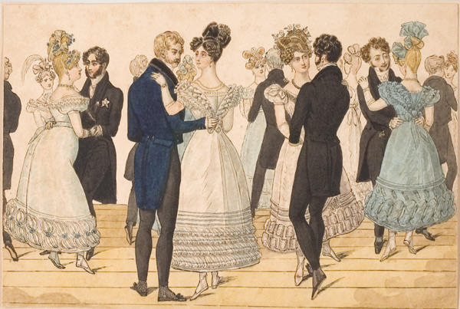
And the ball…
What does it do?
Drawn on screen as small rectangle/square
Moves continuously in a straight line until…
Bounces off walls
Bounces off bats
Resets to middle of screen when it goes off-screen
In code:
Draw function
Update function to move it every frame and test collision with bats and walls
Reset function that sets position to centre of screen and direction to a random vector

Slide 7
Add a score, pull it together and you’re done!
Score needs a draw function and a way to increase the score for each player.
Once we have a class made we can create it in the main ‘pong’ file (I’ve made an empty pygame window for you), call all of it’s functions and see if it works!
Finish all the classes and hopefully you have a finished game.
We are going to try and do this today and next week.
Starter code is on the S: drive, CS Club, this term - in the folder called ‘clone pong’
There are some snippets of helper code in the ‘helpful_code_bits.py’ file
This is making a whole game so it will be tough, if you get stuck try the helpful_code_bits, google (pygame + what you are trying to do) or ask me.
Start with the walls because they are the easiest bit.

Slide 8
You are now a game developer.

